Slide 1


PFIN
GITMAN/ JOEHNK/ BILLINGSLEY
4
8
Insuring Your Life
Copyright ©2016 Cengage Learning. All Rights Reserved. May not be scanned, copied or duplicated, or posted to a publicly accessible website, in whole or in part.

Slide 2
LEARNING OBJECTIVES
Explain the concept of risk and the basics of insurance underwriting
Discuss the primary reasons for life insurance and identify those who need coverage
Calculate how much life insurance you need
Distinguish among the various types of life insurance policies and describe their advantages and disadvantages
Choose the best life insurance policy for your needs at the lowest cost
Become familiar with the key features of life insurance policies
Copyright ©2016 Cengage Learning. All Rights Reserved. May not be scanned, copied or duplicated, or posted to a publicly accessible website, in whole or in part.
PFIN4| CH8

Slide 3

Basic Insurance Concepts
Purpose of insurance
  Protect people from the financial consequences of losing assets or income when an accident, illness, or death occurs
Strategies to prevent financial loss
  Risk avoidance: Avoiding an act that would create a risk
  Loss prevention: Any activity that reduces the probability that a loss will occur
Copyright ©2016 Cengage Learning. All Rights Reserved. May not be scanned, copied or duplicated, or posted to a publicly accessible website, in whole or in part.
PFIN4| CH8

Slide 4
Basic Insurance Concepts
  Loss control: Any activity that lessens the severity of loss once it occurs
  Risk assumption: Choice to accept and bear the risk of loss
  Insurance policy: Insurer agrees to reimburse the insured for any losses suffered according to specified terms
Copyright ©2016 Cengage Learning. All Rights Reserved. May not be scanned, copied or duplicated, or posted to a publicly accessible website, in whole or in part.
PFIN4| CH8

Slide 5
Underwriting
Used by insurers to decide who can be insured and applicable rates for premiums
Helps insurance companies to protect against adverse selection
Practices and standards vary among insurance companies
Copyright ©2016 Cengage Learning. All Rights Reserved. May not be scanned, copied or duplicated, or posted to a publicly accessible website, in whole or in part.
PFIN4| CH8

Slide 6
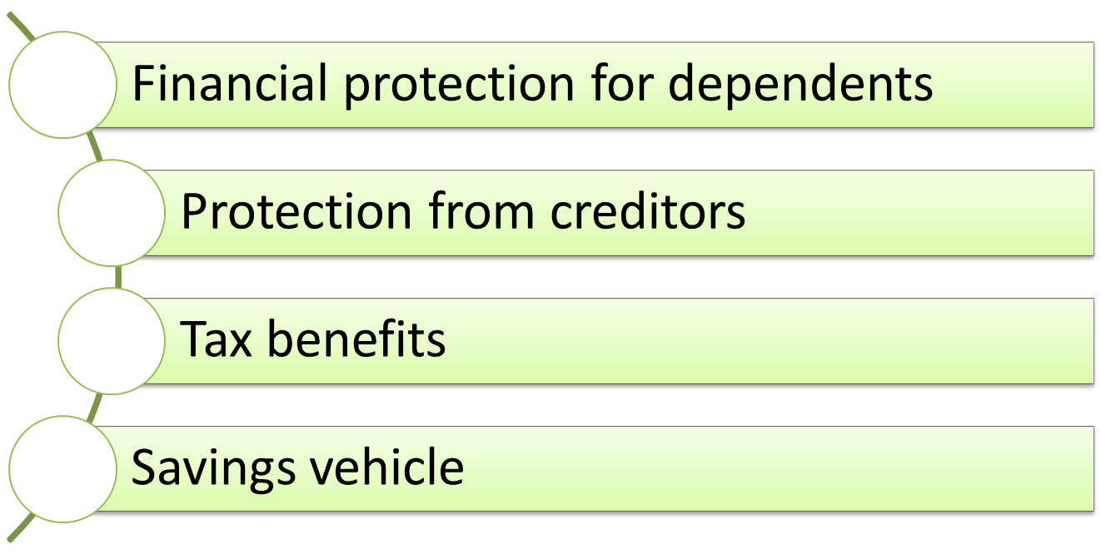
Benefits of Life Insurance
Copyright ©2016 Cengage Learning. All Rights Reserved. May not be scanned, copied or duplicated, or posted to a publicly accessible website, in whole or in part.
PFIN4| CH8

Slide 7
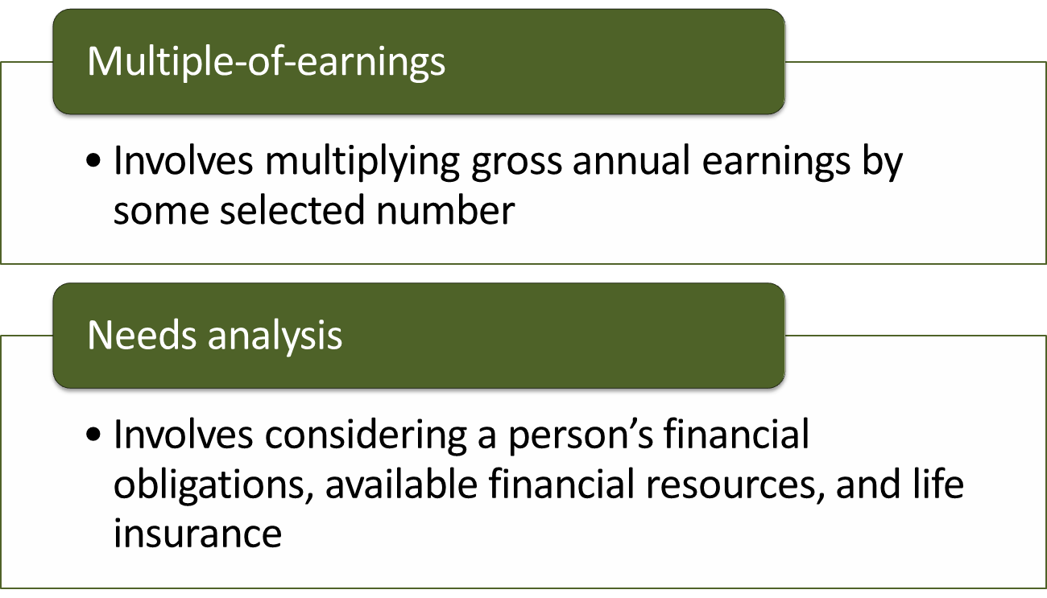
Methods to Estimate the Required Amount of Insurance
Copyright ©2016 Cengage Learning. All Rights Reserved. May not be scanned, copied or duplicated, or posted to a publicly accessible website, in whole or in part.
PFIN4| CH8

Slide 8
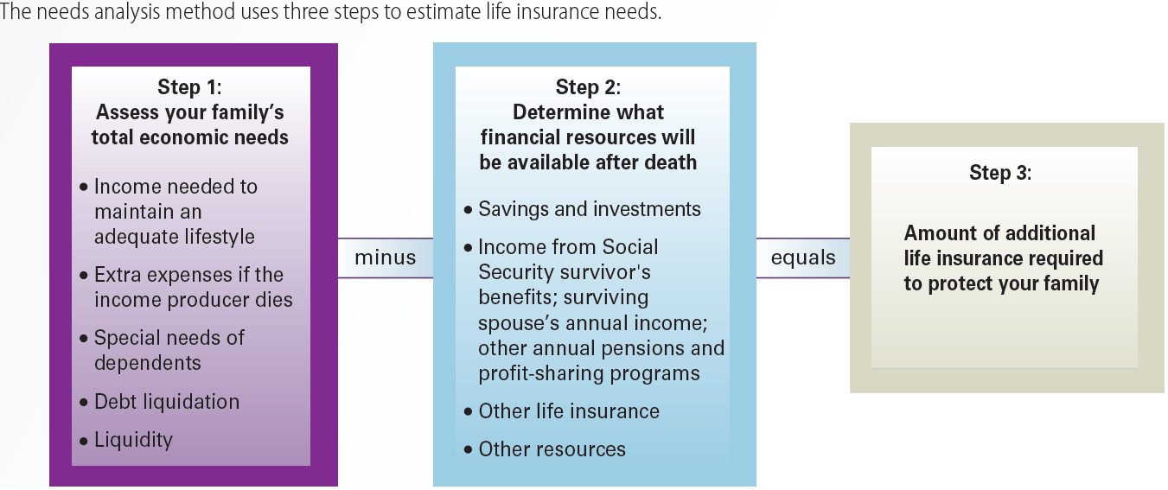
Exhibit 8.1
How Much Life Insurance Do You Need?
Copyright ©2016 Cengage Learning. All Rights Reserved. May not be scanned, copied or duplicated, or posted to a publicly accessible website, in whole or in part.
PFIN4| CH8

Slide 9
Term Life Insurance
Provides death benefits for a specified period
Does not provide for the accumulation of cash value
Types
  Straight term policy: Coverage remains unchanged throughout the effective period
  Decreasing term policy: Premium remains unchanged while coverage decreases
Copyright ©2016 Cengage Learning. All Rights Reserved. May not be scanned, copied or duplicated, or posted to a publicly accessible website, in whole or in part.
PFIN4| CH8

Slide 10
Whole Life Insurance
Provides permanent insurance coverage during an individual’s entire life
Cash value: Accumulated refundable value of an insurance policy
  Results from the investment earnings on paid-in insurance premiums
Nonforfeiture right: Provides policyholder the assets allotted for future death claim, upon policy cancellation
Copyright ©2016 Cengage Learning. All Rights Reserved. May not be scanned, copied or duplicated, or posted to a publicly accessible website, in whole or in part.
PFIN4| CH8

Slide 11
Types of Whole Life Policies
Continuous premium
  Premiums should be paid until death or policy cancellation
Limited payment
  Premiums should be paid for specified number of years
  Insurance is effective until death
Single premium
  Lifetime coverage purchased with a single premium
Copyright ©2016 Cengage Learning. All Rights Reserved. May not be scanned, copied or duplicated, or posted to a publicly accessible website, in whole or in part.
PFIN4| CH8

Slide 12
Universal Life Insurance
Permanent cash-value insurance
Combines term insurance with a tax-sheltered savings account
Death protection and savings portion premiums are unbundled
Copyright ©2016 Cengage Learning. All Rights Reserved. May not be scanned, copied or duplicated, or posted to a publicly accessible website, in whole or in part.
PFIN4| CH8

Slide 13
Other Types of Life Insurance
Variable life insurance: Coverage amount varies with the profits generated in the investment account
Group life insurance: Provides a master policy for a group
  Each eligible group member receives a certificate of insurance
Copyright ©2016 Cengage Learning. All Rights Reserved. May not be scanned, copied or duplicated, or posted to a publicly accessible website, in whole or in part.
PFIN4| CH8

Slide 14
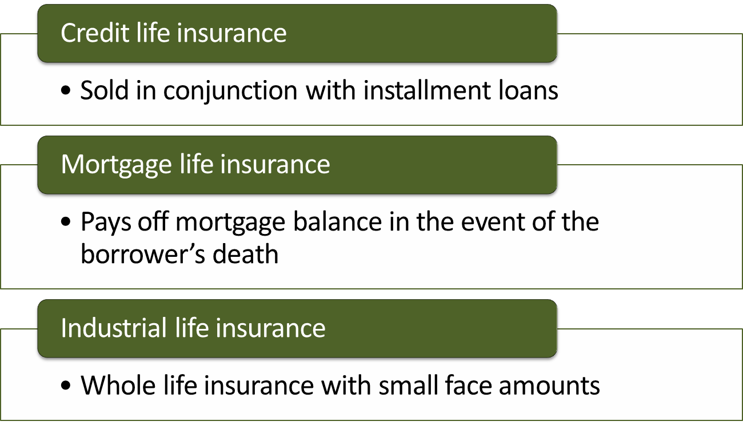
Other Types of Life Insurance
Copyright ©2016 Cengage Learning. All Rights Reserved. May not be scanned, copied or duplicated, or posted to a publicly accessible website, in whole or in part.
PFIN4| CH8

Slide 15
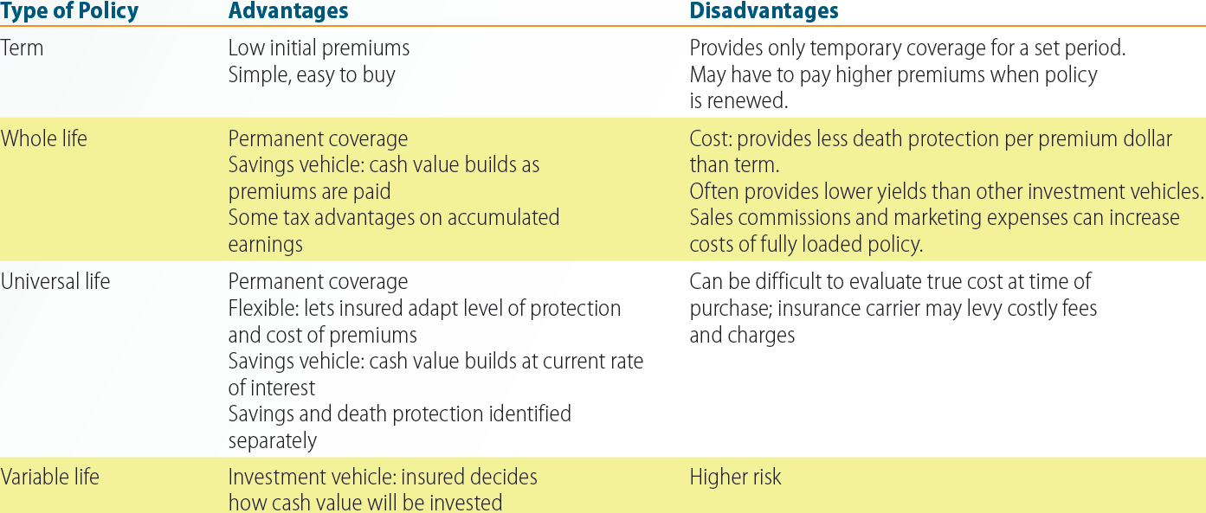
Exhibit 8.8
Advantages and Disadvantages of the Most Popular Types of Life Insurance
Copyright ©2016 Cengage Learning. All Rights Reserved. May not be scanned, copied or duplicated, or posted to a publicly accessible website, in whole or in part.
PFIN4| CH8

Slide 16
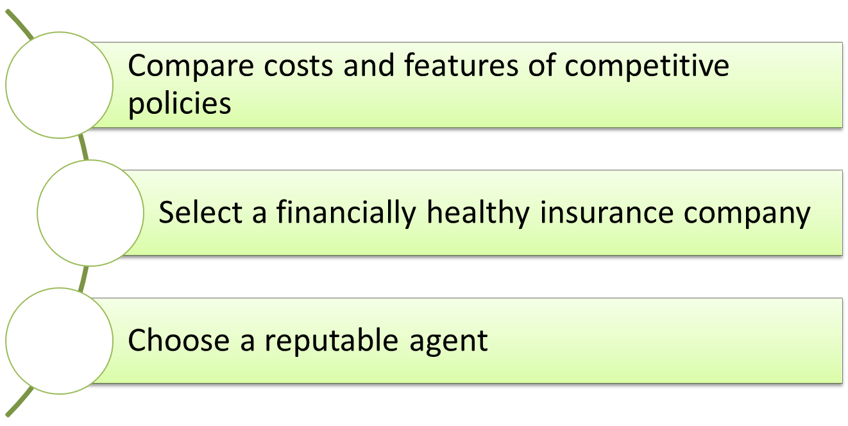
Strategies Involved in Buying Life Insurance
Copyright ©2016 Cengage Learning. All Rights Reserved. May not be scanned, copied or duplicated, or posted to a publicly accessible website, in whole or in part.
PFIN4| CH8

Slide 17
Life Insurance Contract Features
Beneficiary clause - All life insurance policies should have one or more beneficiaries
Settlement options
  Lump sum
  Interest only
  Fixed period
  Fixed amount
  Life income
Policy loan: Advance secured by the cash value of a whole life insurance policy
Copyright ©2016 Cengage Learning. All Rights Reserved. May not be scanned, copied or duplicated, or posted to a publicly accessible website, in whole or in part.
PFIN4| CH8

Slide 18
Life Insurance Contract Features
Premium payments
Grace period
Nonforfeiture options
  Paid-up insurance
  Extended term insurance
Policy reinstatement
Change of policy
Copyright ©2016 Cengage Learning. All Rights Reserved. May not be scanned, copied or duplicated, or posted to a publicly accessible website, in whole or in part.
PFIN4| CH8

Slide 19
Other Policy Features
Multiple indemnity clause: Doubles or triples the policy’s face amount if the insured dies in an accident
Disability clause: Includes a waiver-of-premium benefit alone or coupled with disability income
Guaranteed purchase option: Right to purchase additional coverage without providing evidence of insurability
Copyright ©2016 Cengage Learning. All Rights Reserved. May not be scanned, copied or duplicated, or posted to a publicly accessible website, in whole or in part.
PFIN4| CH8

Slide 20
Other Policy Features
Suicide clause
Exclusions
Participation
Living benefits
Viatical settlement
Copyright ©2016 Cengage Learning. All Rights Reserved. May not be scanned, copied or duplicated, or posted to a publicly accessible website, in whole or in part.
PFIN4| CH8

Slide 21
Life Insurance Policy Illustration
Includes the important assumptions that the insurance company relies on when presenting the policy to a prospective client
Consists of two parts
  Guaranteed illustration
  Current illustration
Copyright ©2016 Cengage Learning. All Rights Reserved. May not be scanned, copied or duplicated, or posted to a publicly accessible website, in whole or in part.
PFIN4| CH8

Slide 22
Life Insurance Policy Illustration
Ensure the following sections are present in the narrative summary
  Policy description, terms, and features
  Underwriting discussion
  Column definitions and key terms
  Disclaimer
  Signature page
Copyright ©2016 Cengage Learning. All Rights Reserved. May not be scanned, copied or duplicated, or posted to a publicly accessible website, in whole or in part.
PFIN4| CH8

Slide 23
KEY TERMS
Risk avoidance
Loss prevention
Loss control
Risk assumption
Insurance policy
Underwriting
Multiple-of-earnings method
Needs analysis method
Social Security survivor’s benefits
Term life insurance
Straight term policy
Decreasing term policy
Renewability
Convertibility
Whole life insurance
Cash value
Copyright ©2016 Cengage Learning. All Rights Reserved. May not be scanned, copied or duplicated, or posted to a publicly accessible website, in whole or in part.
PFIN4| CH8

Slide 24
KEY TERMS
Nonforfeiture right
Universal life insurance
Variable life insurance
Group life insurance
Credit life insurance
Mortgage life insurance
Industrial life insurance
Beneficiary
Policy loan
Multiple indemnity clause
Disability clause
Guaranteed purchase option
Participating policy
Life insurance policy illustration
Copyright ©2016 Cengage Learning. All Rights Reserved. May not be scanned, copied or duplicated, or posted to a publicly accessible website, in whole or in part.
PFIN4| CH8

Slide 25
SUMMARY
Insurance policies protect people from the financial consequences of losing assets
Individuals must choose policies based on their economic needs and available financial resources
Several insurance policies are available with specific set of features
  Each has its own advantages and disadvantages
Copyright ©2016 Cengage Learning. All Rights Reserved. May not be scanned, copied or duplicated, or posted to a publicly accessible website, in whole or in part.
PFIN4| CH8

Slide 26


